Slide 1
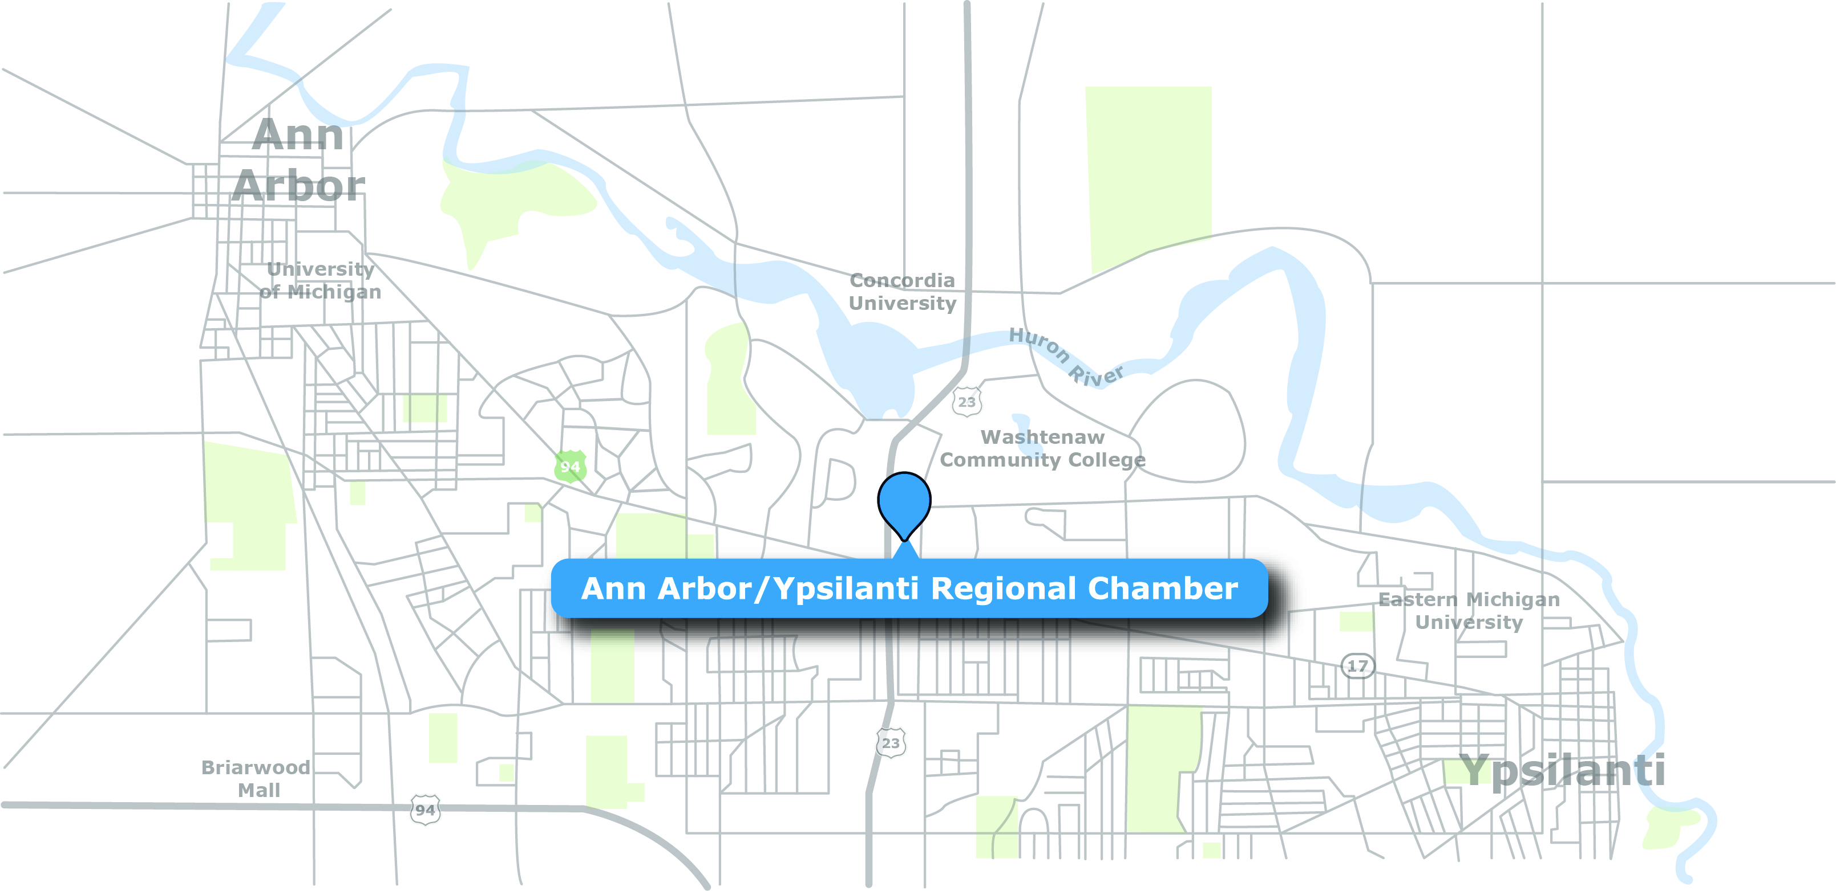
A2Y Chamber is on the Move!

Slide 2
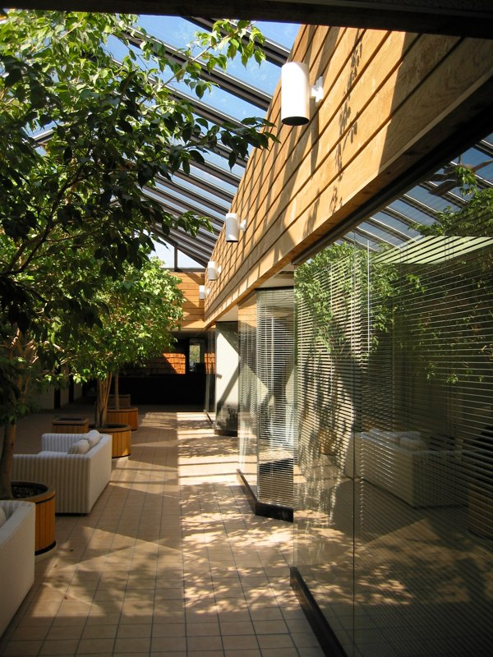
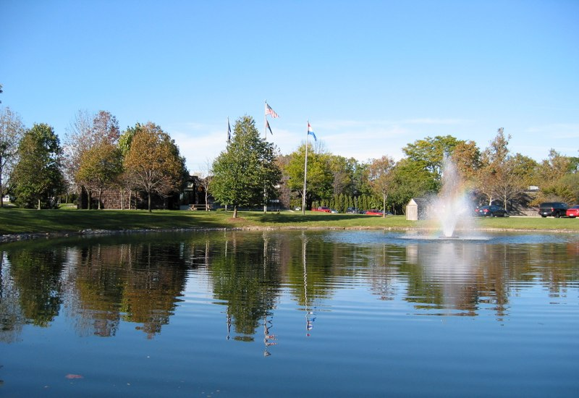
Atria Business Park 2010 Hogback Rd. Suite 4

Slide 3
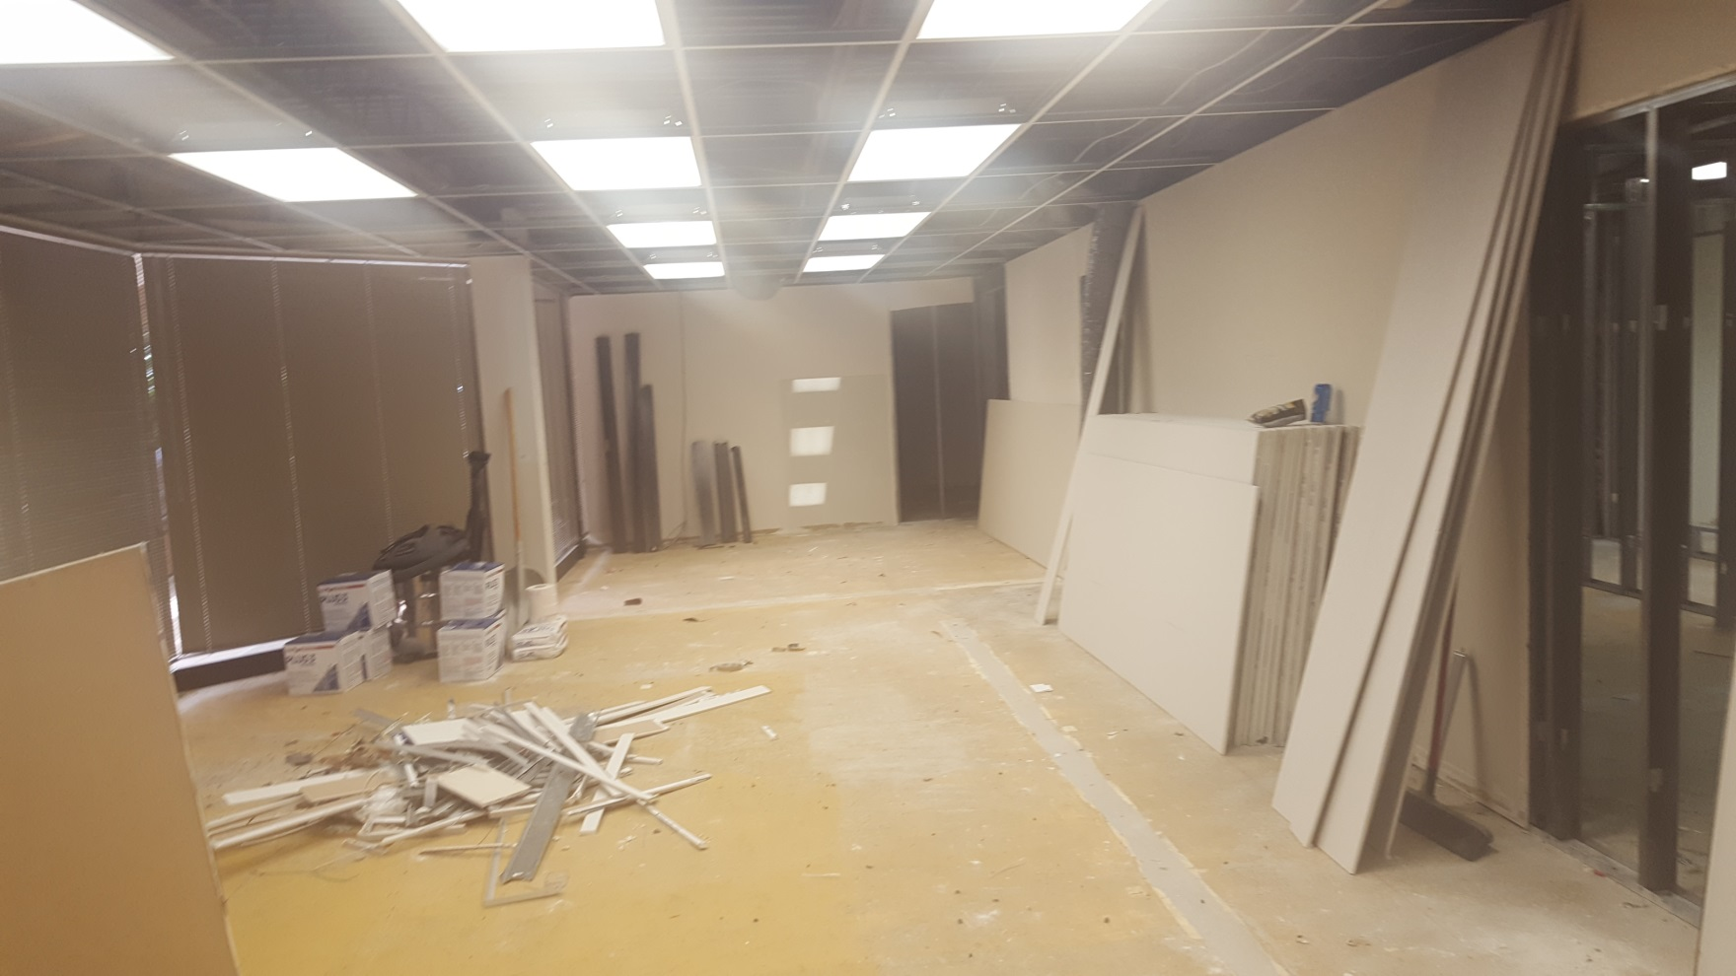
Board Room Before….

Slide 4
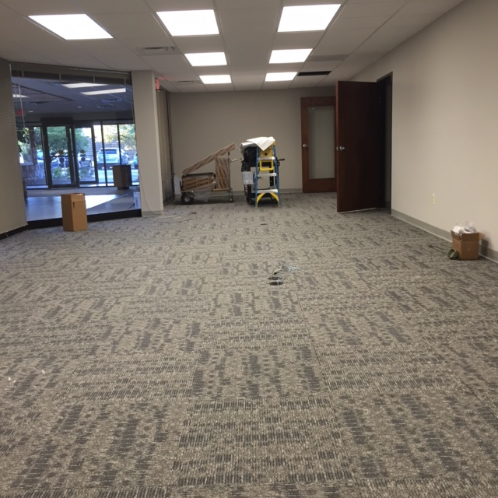
Board Room Now!

Slide 5
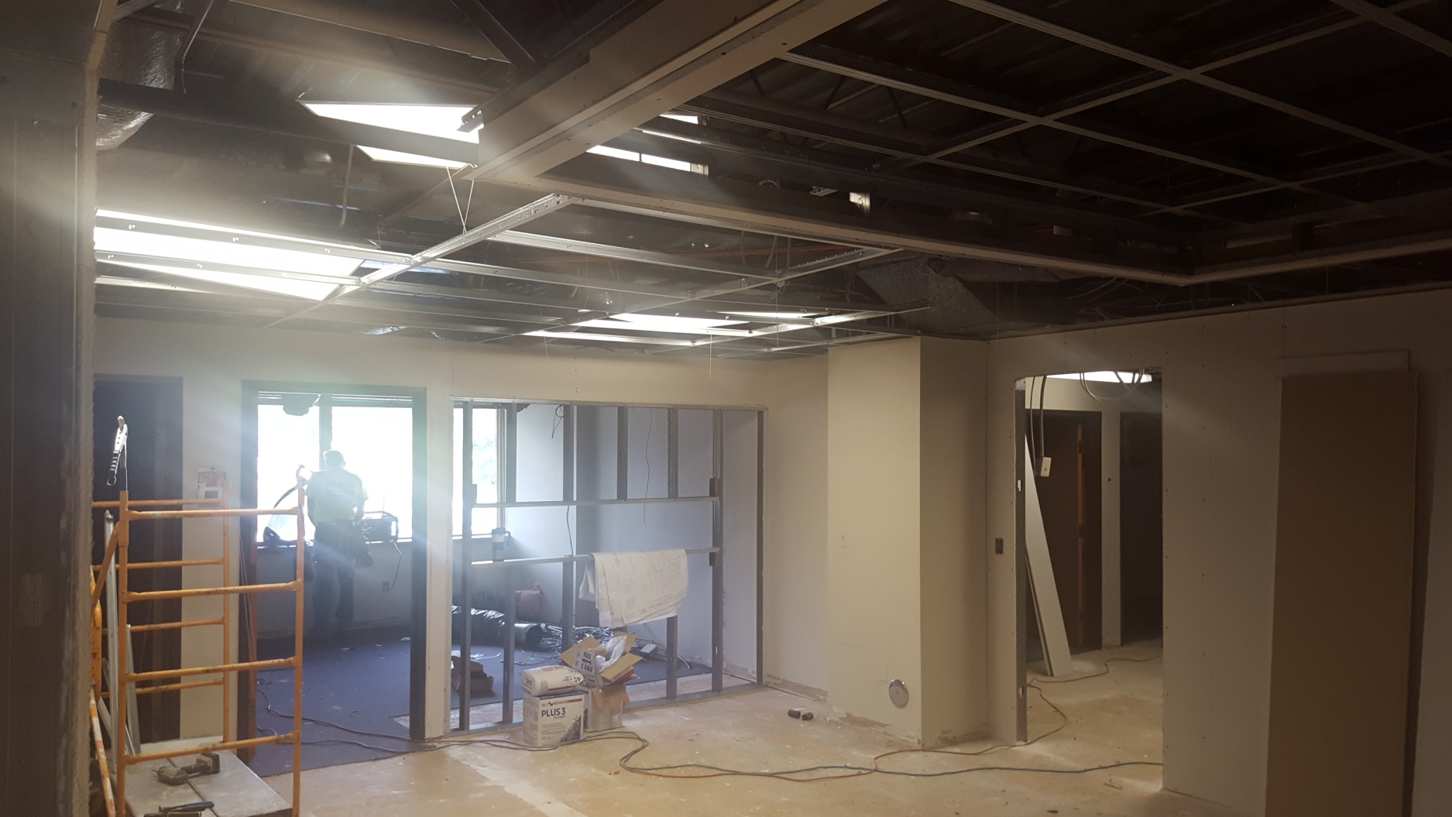
Entryway Before…

Slide 6
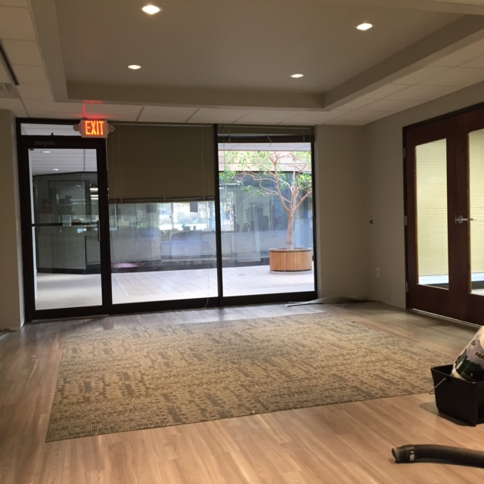
Entryway Now!

Slide 7
A2Y Chamber New Look

